Slide 1


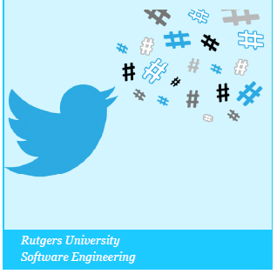
Health Monitor Analytics
Group 1 Oct.31,2014
D. Takacs G. Bati J.Abdulbaqi I. Paraskevakos K.Dong

Slide 2
Feature
PerCapita Map with weighted tweets based on population density.
Competitive game: active people gain points via # of tweets with time.
Interactive map: shows tweets via types of activates.
Activities recommendation based on both weather and tweets.
CalorieMeter: tracking apps & devices tweets.

Slide 3
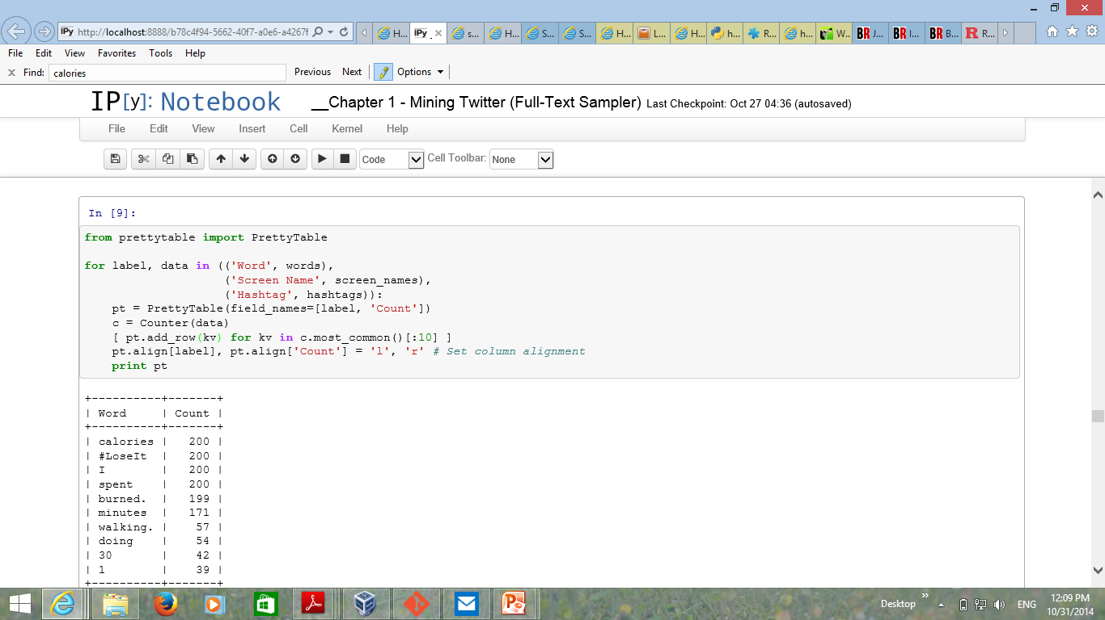
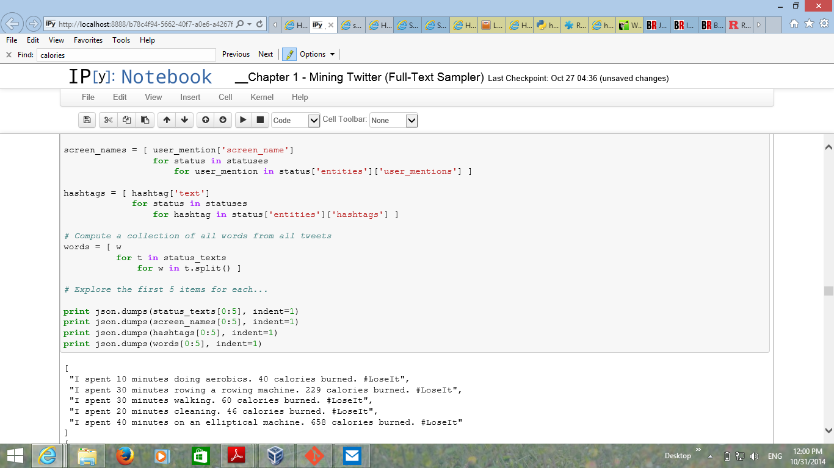
CalorieMeter
Google Fit, Microsoft Band, etc… (Many Apps + wearables)
Innovation?
Accurate Analysis of the problem (Accurate Data) TweetChup (Done)
Calculating Calories + Visualizing them in site + adding more features (Reqs)(To be done)

Slide 4
What we did Right now
Getting the data from twitter.
Save the data in the MongoDB.
Represent the twitter data into google map after saving it in MongoDB.
PerCapita Map for Discrete group of large cities.
Create the game system for the states based on the tweets from the database and store them in the database.
Accurate Analysis of the problem (Accurate Data) TweetChup

Slide 5
Future Improvements
PerCapita Map:
PerCapita Map for Continuous US (All Towns)
Competitive game:
Test everything and display it to the web site
Interactive map:
Recognize each type of activities to represent most popular one in single map
Activities recommendation:
Complete the Recommendation function based on Interactive Map
CalorieMeter
Calculating Calories + Visualizing them in site + adding more features

Slide 6
Thank you!

